Slide 1
ours of the night
“Under sleep, where all the waters meet . . .”
T.S. Eliot, Marina
hours of the night
M.D. Coverley – Stephanie Strickland

Slide 2
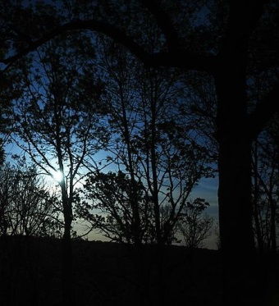
. . . long ago most people slept in two separate intervals
each night . . . a first sleep after dusk followed by
one or two waking hours . . . then back to bed
till dawn . . .
18:00

Slide 3
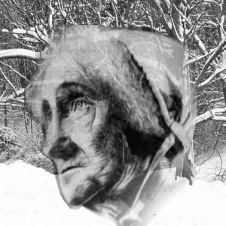
. . . our night hours also break
into many parts . . .
19:00

Slide 4
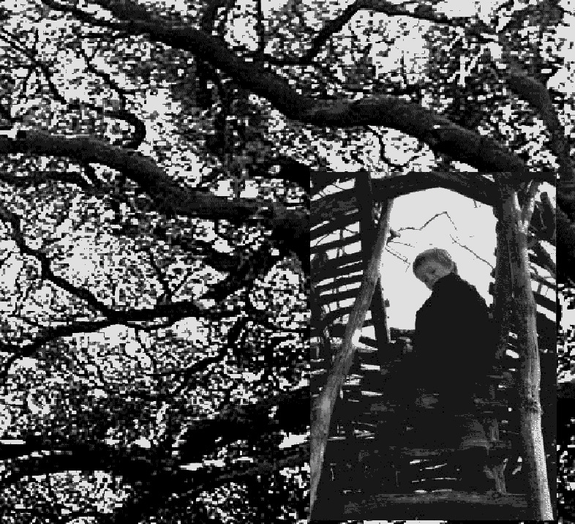

up the stairs
20:00

Slide 5
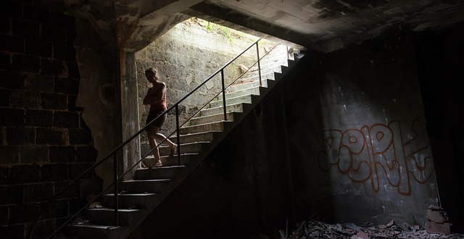

down the stairs
21:00

Slide 6
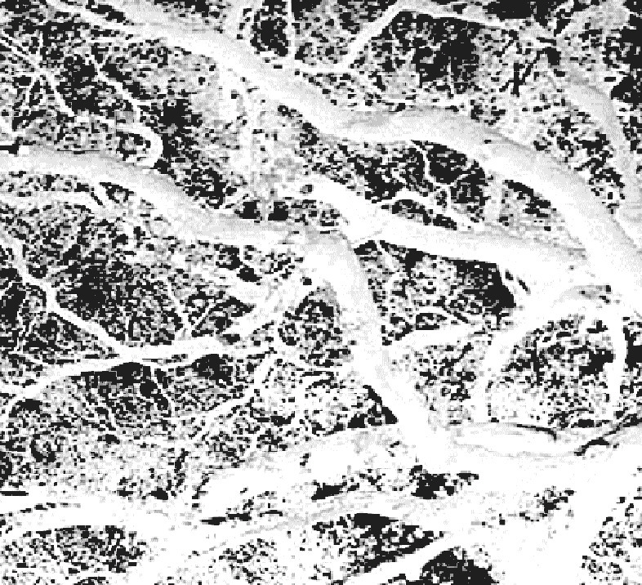

keep track
do more
still undone still undone
don’t forget
tense alert hard to sleep
22:00

Slide 7
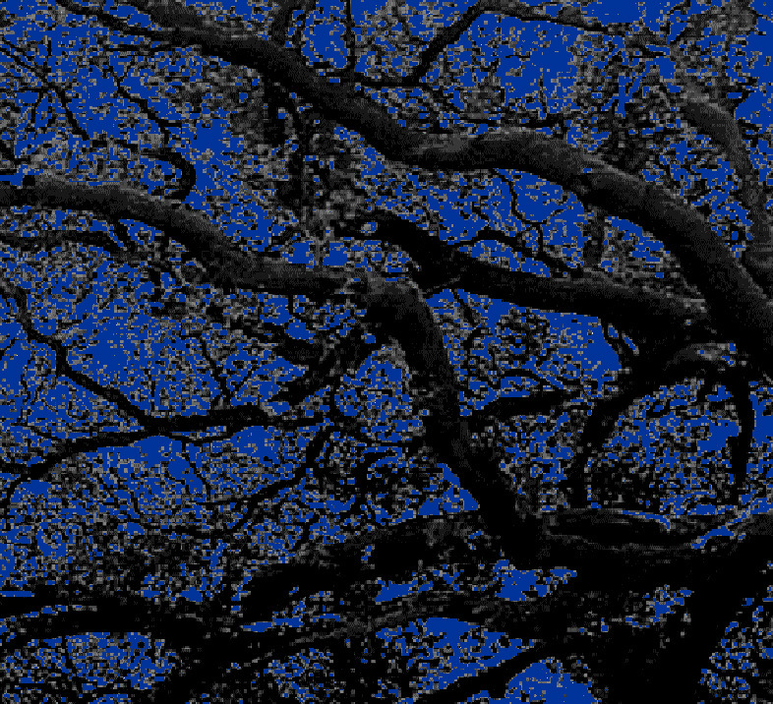
. . . in the unlit night loosening
boundaries that bind
us by day . . .
sink
settle
23:00

Slide 8
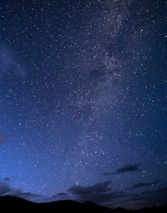
release . . .
erase
24:00

Slide 9
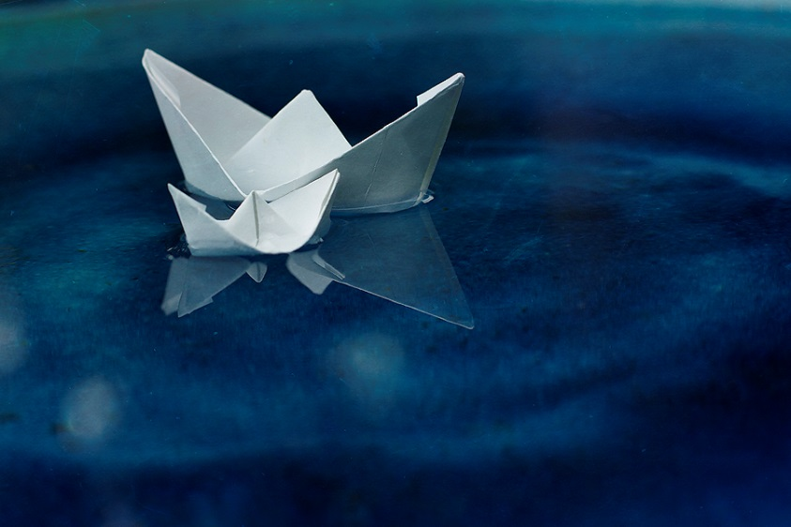

. . . those who live solely by natural light revert ……….to ancient “segmented sleep” . . .
1:00

Slide 10
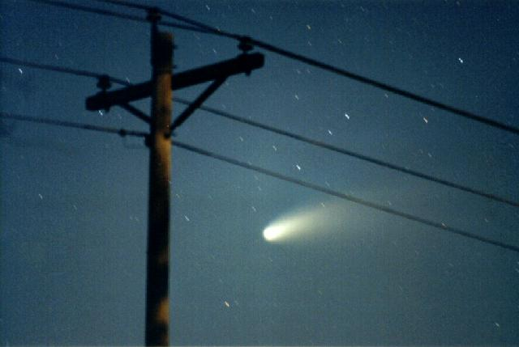
awake now . . .
2:00

Slide 11
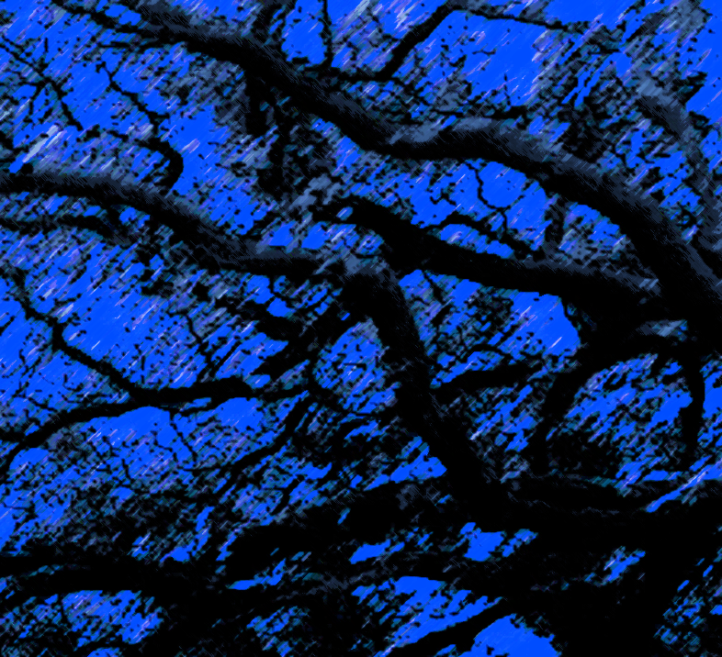
back to sleep
3:00

Slide 12
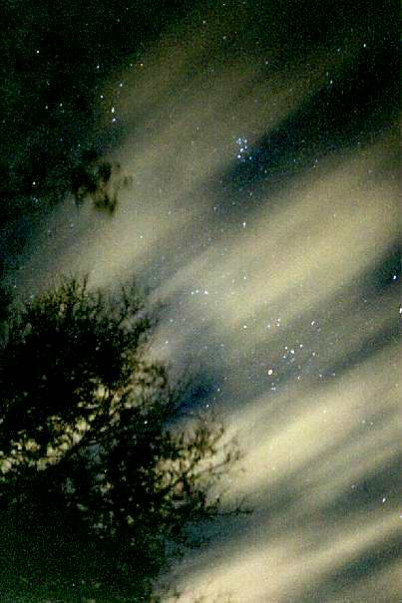

waking again
sky filled with light . . . high wind
4:00

Slide 13
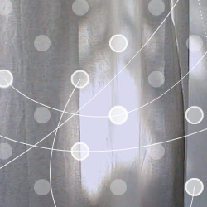
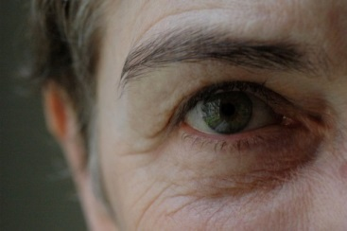
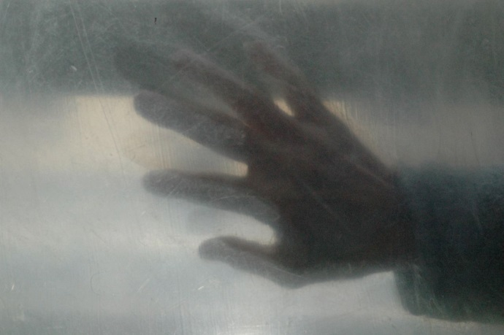
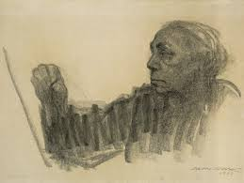
face myself
5:00

Slide 14
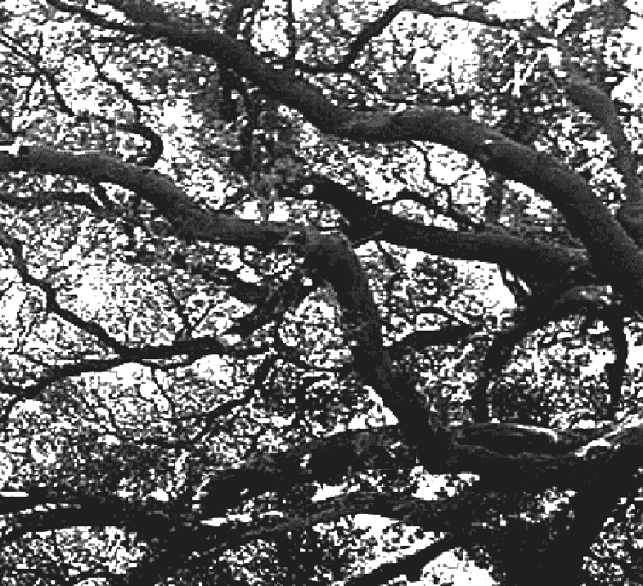
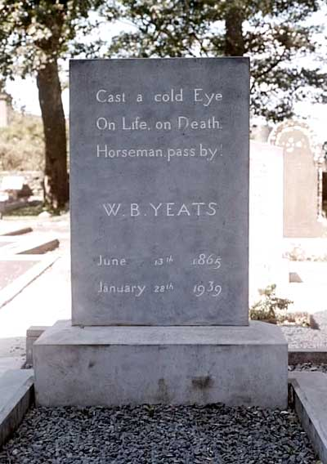

at dawn
rise
6:00

Slide 15
A PowerPoint Poem
hours of the night
Self Portrait 1933: Käthe Kollwitz
Sky Photos: Keith Cooley
Technical Advice: Jules Chatelain
M.D. Coverley – Stephanie Strickland
http://califia.us http://stephaniestrickland.com
2015

